Slide 1
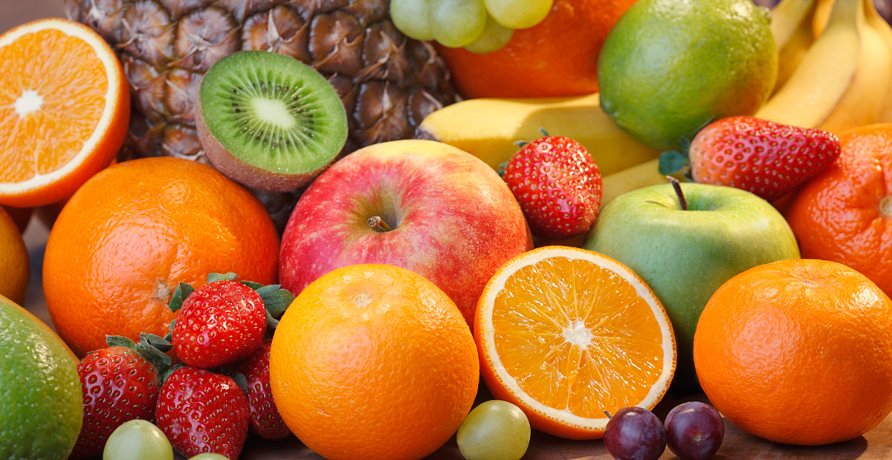
NUTRITION ANALYSIS USING IMAGE CLASSIFICATION
Team members:
Saranya.E
Preethika.S
Santhini.B

Slide 2
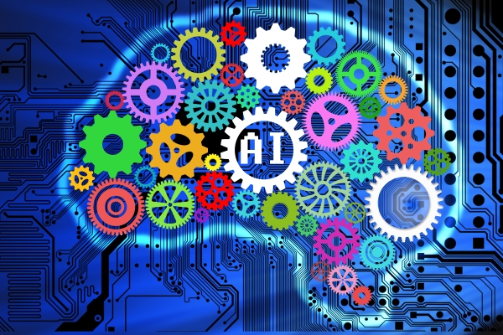
Artificial intelligence (AI) emphasizes the creation of intelligent machines that work and react like humans.
What is Artificial Intelligence(AI)?

Slide 3

Programming languages used in AI

Slide 4
What is Machine Learning?
Machine Learning is a subset of AI
It provides machines the ability to learn automatically and improve from experience without being explicitly programmed.

Slide 5
Limitations of ML:
One of the big challenges in ML models is process called feature extraction.
2.For problems such as object recognition or handwriting recognition is difficult.

Slide 6
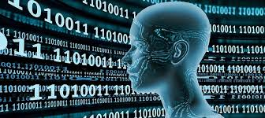
What is deep learning?
Deep learning is implemented through neural networks.
It is subset of ML
To handle huge amount of data

Slide 7
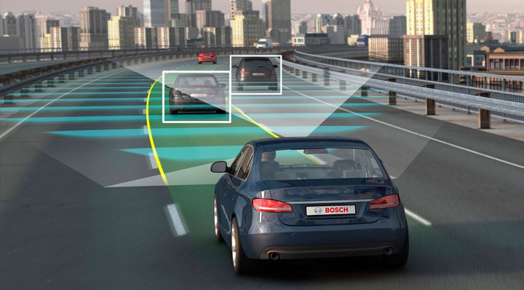

Applications of DL
Self driving cars
Automatic machine translation
Self driving cars

Slide 8
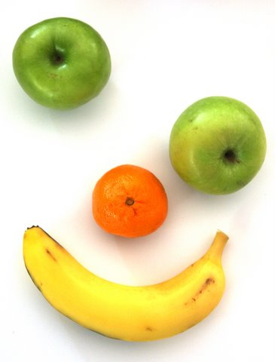
Aim of the project
The objective of this research project is to find nutritions of the detected fruit and the name of the fruit using image classification.
So that the people could maintain a healthy life.

Slide 9
Methodology
Convolution Neural Network algorithm(CNN) is used.
It helps to extract the important features from the images and train them

Slide 10
Example

Slide 11
Steps in CNN
Convolution
Max pooling
Flattening
Full connection

Slide 12
CNN’s are feed forward neural networks
The input layer is fed with input features(in case of images ,they are the pixels)and there are no loops in the network.
The output layer applies activation functions and classifies object into the respective class.

Slide 13
Continuation-
The moving ahead of features as weighted sum from input layer to hidden layer to output layer is called Feed forwarding.
The process of moving back the layers to adjust/correct the error and learning the object is called backward propagation.
One whole transition of these two is called epoch.

Slide 14
Datasets
Training dataset-600 images
Testing dataset-200 images
Labels:
Apple
Banana
Straw berry
kiwi

Slide 15
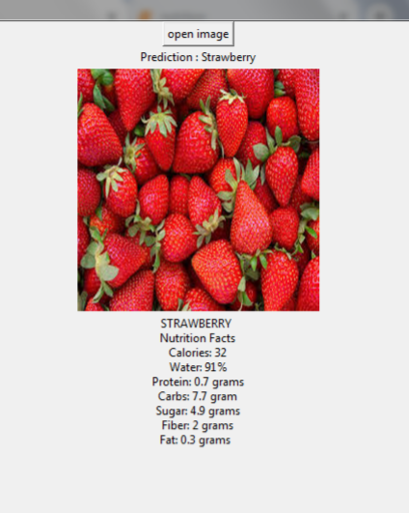
Predictions

Slide 16
Conclusion
Thus I conclude by saying that convolutional neural network(CNN) would be a best technique for image classifiction which can be extended to several stated applications.

